Slide 1




Prototype Mover Robot
ENGINEERING 141 - Honors Creativity and Innovation in Engineering Design I
Kathryn Atherton, Ryan Hellyer, Natalie Zimmermann
Notes:
Good Afternoon. We are Team 59, Planes, Trains, and Biological Things, and we are here to present our results from our PMR design development for Harris under Purdue Honors Engineering.

Slide 2
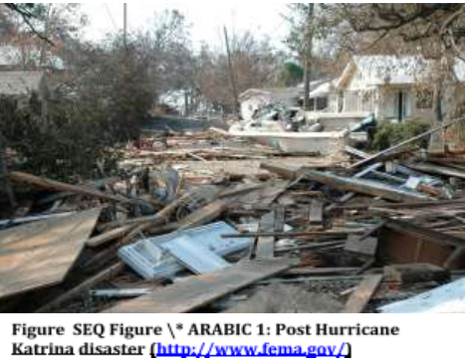
INTRODUCTION
Harris company made a request for a Prototype Mover Robot (PMR) to transport debris from disaster sites for processing
Without wheels or treads
Follow a line
Pick up bins
Identify bin content
Transport to drop-off location
Notes:
Our team was tasked with creating a PMR to transport debris from disaster sites for processing with the requirements that it may not have wheels or treads, follow a line around a closed-loop path, pick up bins filled with debris, identify the contents of the bin autonomously, and transport the bin to its designated drop-off location.

Slide 3
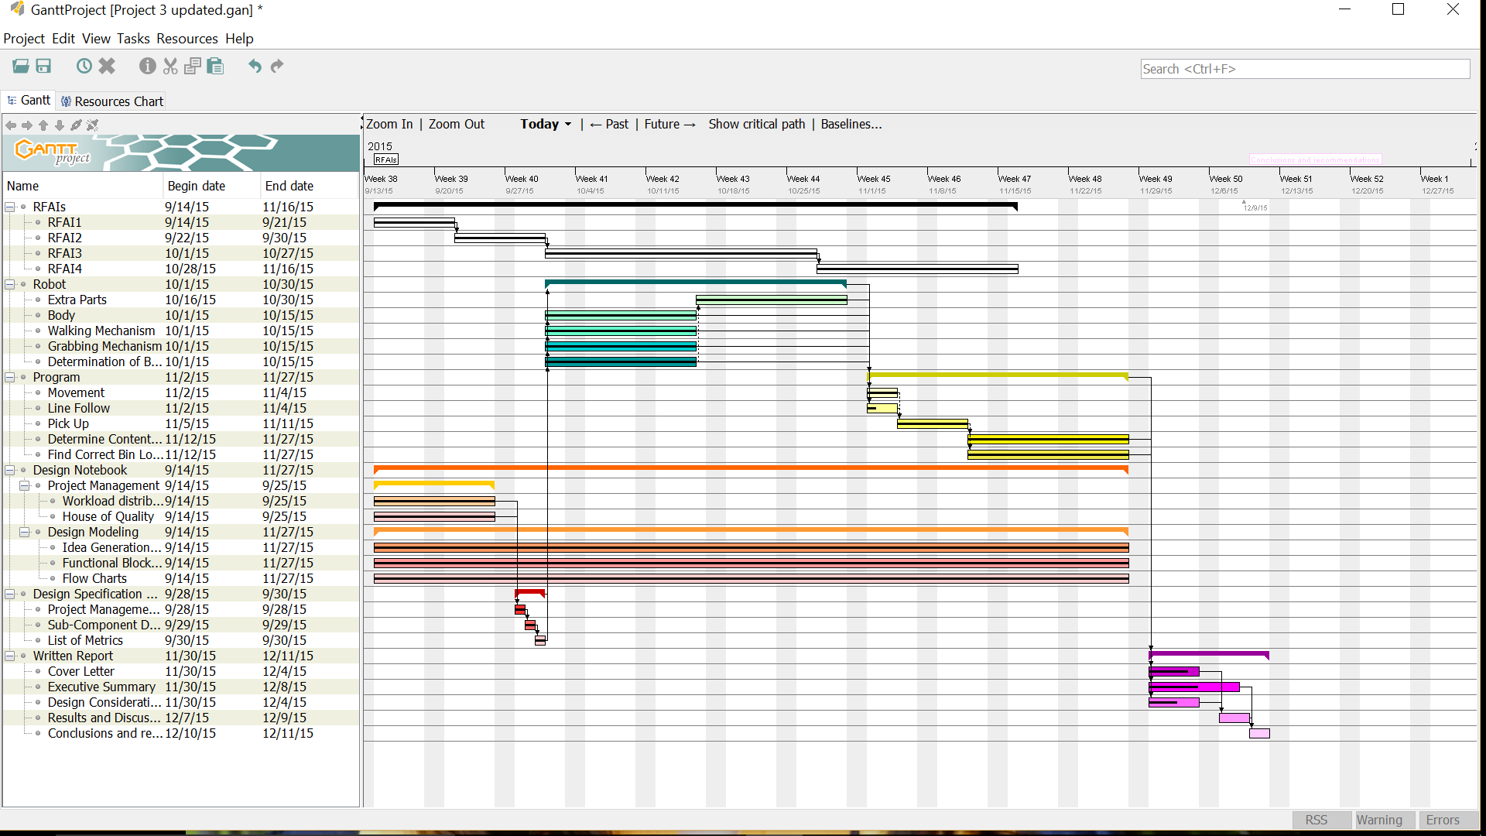
TEAM STRATEGIES
Each month, a different deliverable was the main focus of the group
October: Robot Structure/Mechanism
November: Logic and coding
December: Results and Report
Each deliverable was worked on throughout the entire process, but in order to keep the project on schedule, the group shifted focus with the change of each month
Notes:
In order to keep the design process on track and advance in the project development, the team focused on a different deliverable each month: october: building the robot, getting the basic structure down, november: completing the logic, december: coming up with results and writing the report
Still, to ensure that all the deliverables correctly integrated with each other, the various parts were continually adapted to ensure that they were compatible with the overall development of the product.

Slide 4
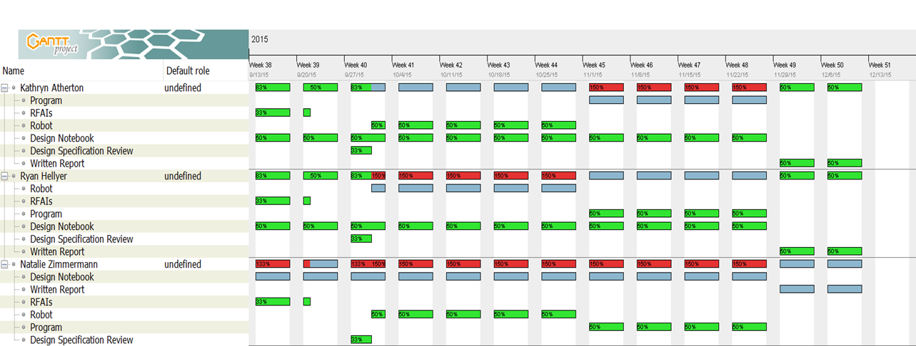
WORKLOAD DISTRIBUTION
Optimized skills of group members in determining leadership for various deliverables
Robot: Ryan
Code: Kathryn
Notebook: Natalie
Each group member was to take the lead on their assigned task, but all group members worked together on all deliverables
Notes:
In order to distribute all the work, and optimizing the skills of each member a workload distribution was created. Every group member was the lead on a certain task. Ryan was in charge of the physical robot, Kathryn in charge of the Software, and I was in charge of keeping up with the paperwork. Still, all group members worked together on all deliverables to ensure that everyone was on the same page on the product development. The overall cooperation was also very useful when brainstorming for solutions, since each member had a different point of view of the project.

Slide 5
DESIGN PHILOSOPHY
Problem Definition: defined problem based on description, created design specifications based on Harris Corp. requirements to determine utility of different designs
Research: past designs for robots without wheels, inspiration from nature, learned about NXT logic and coding skills, became familiar with parts of kit
Brainstorming: created morphological chart of various ideas for the subcomponents of the robot and tested them using simulations
Implementing: created prototypes based on ideas from morphological chart
Testing: tested prototypes against design specifications created
Decision-Making: combined the most successful aspects of each prototype to create best PMR
Notes:
First of all, the problem was defined and engineering specifications were created. These were very useful when testing each prototype, to determine if it was actually going to perform as expected and meet the minimum requirements.
Next, we familiarized ourselves with material given, the NXT software,
Then, we brainstormed methods to solve the problem given and gathered them in a morphological chart
Afterwards we created the different prototypes with the different elements and tested them against the specifications
Finally, we collected all the data nd determined the most successful mechanisms for each part.

Slide 6
Engineering specifications to determine success
Velocity | More than 0.6 feet per second
Deviation from the line | Less than 1/10 of the distance traveled
Turning radius | Less than 4 inches
Find a line | Less than 5 seconds
Obstacle traversal | Higher than 1 inch
Weight transported | More than 250 grams
Distance to drop-off location | Less than 3 inches to the center of the drop-off location
Notes:
These are the engineering specifications that we developed in order to determine whether or not our design was successful, based on the project description and the answers to the Requests for Additional Information from Harris.

Slide 7
DESIGNS
Function | Mean
Walking | 2 bars as feet “elephant” | 3 or 4 legs on each side “spider” |  |  |  |  | Combination 2 bars on each side with 4 legs
Pick - Up | Hook |  |  |  | Forklift
Bin Identification | Displacement of the hook |  |  |  | Power needed to lift the weight
Drop-Off Location | Touch Sensor - Walk into bin-drop off point identifier |  |  |  | Ultrasonic Sensor - Stop at a certain distance when object detected
Bin Location | Touch Sensor - Encounter bin
Notes:
Using a variety of brainstorming strategies, including inspiration from nature, we determined a number of design possibilities for completing each task.

Slide 8
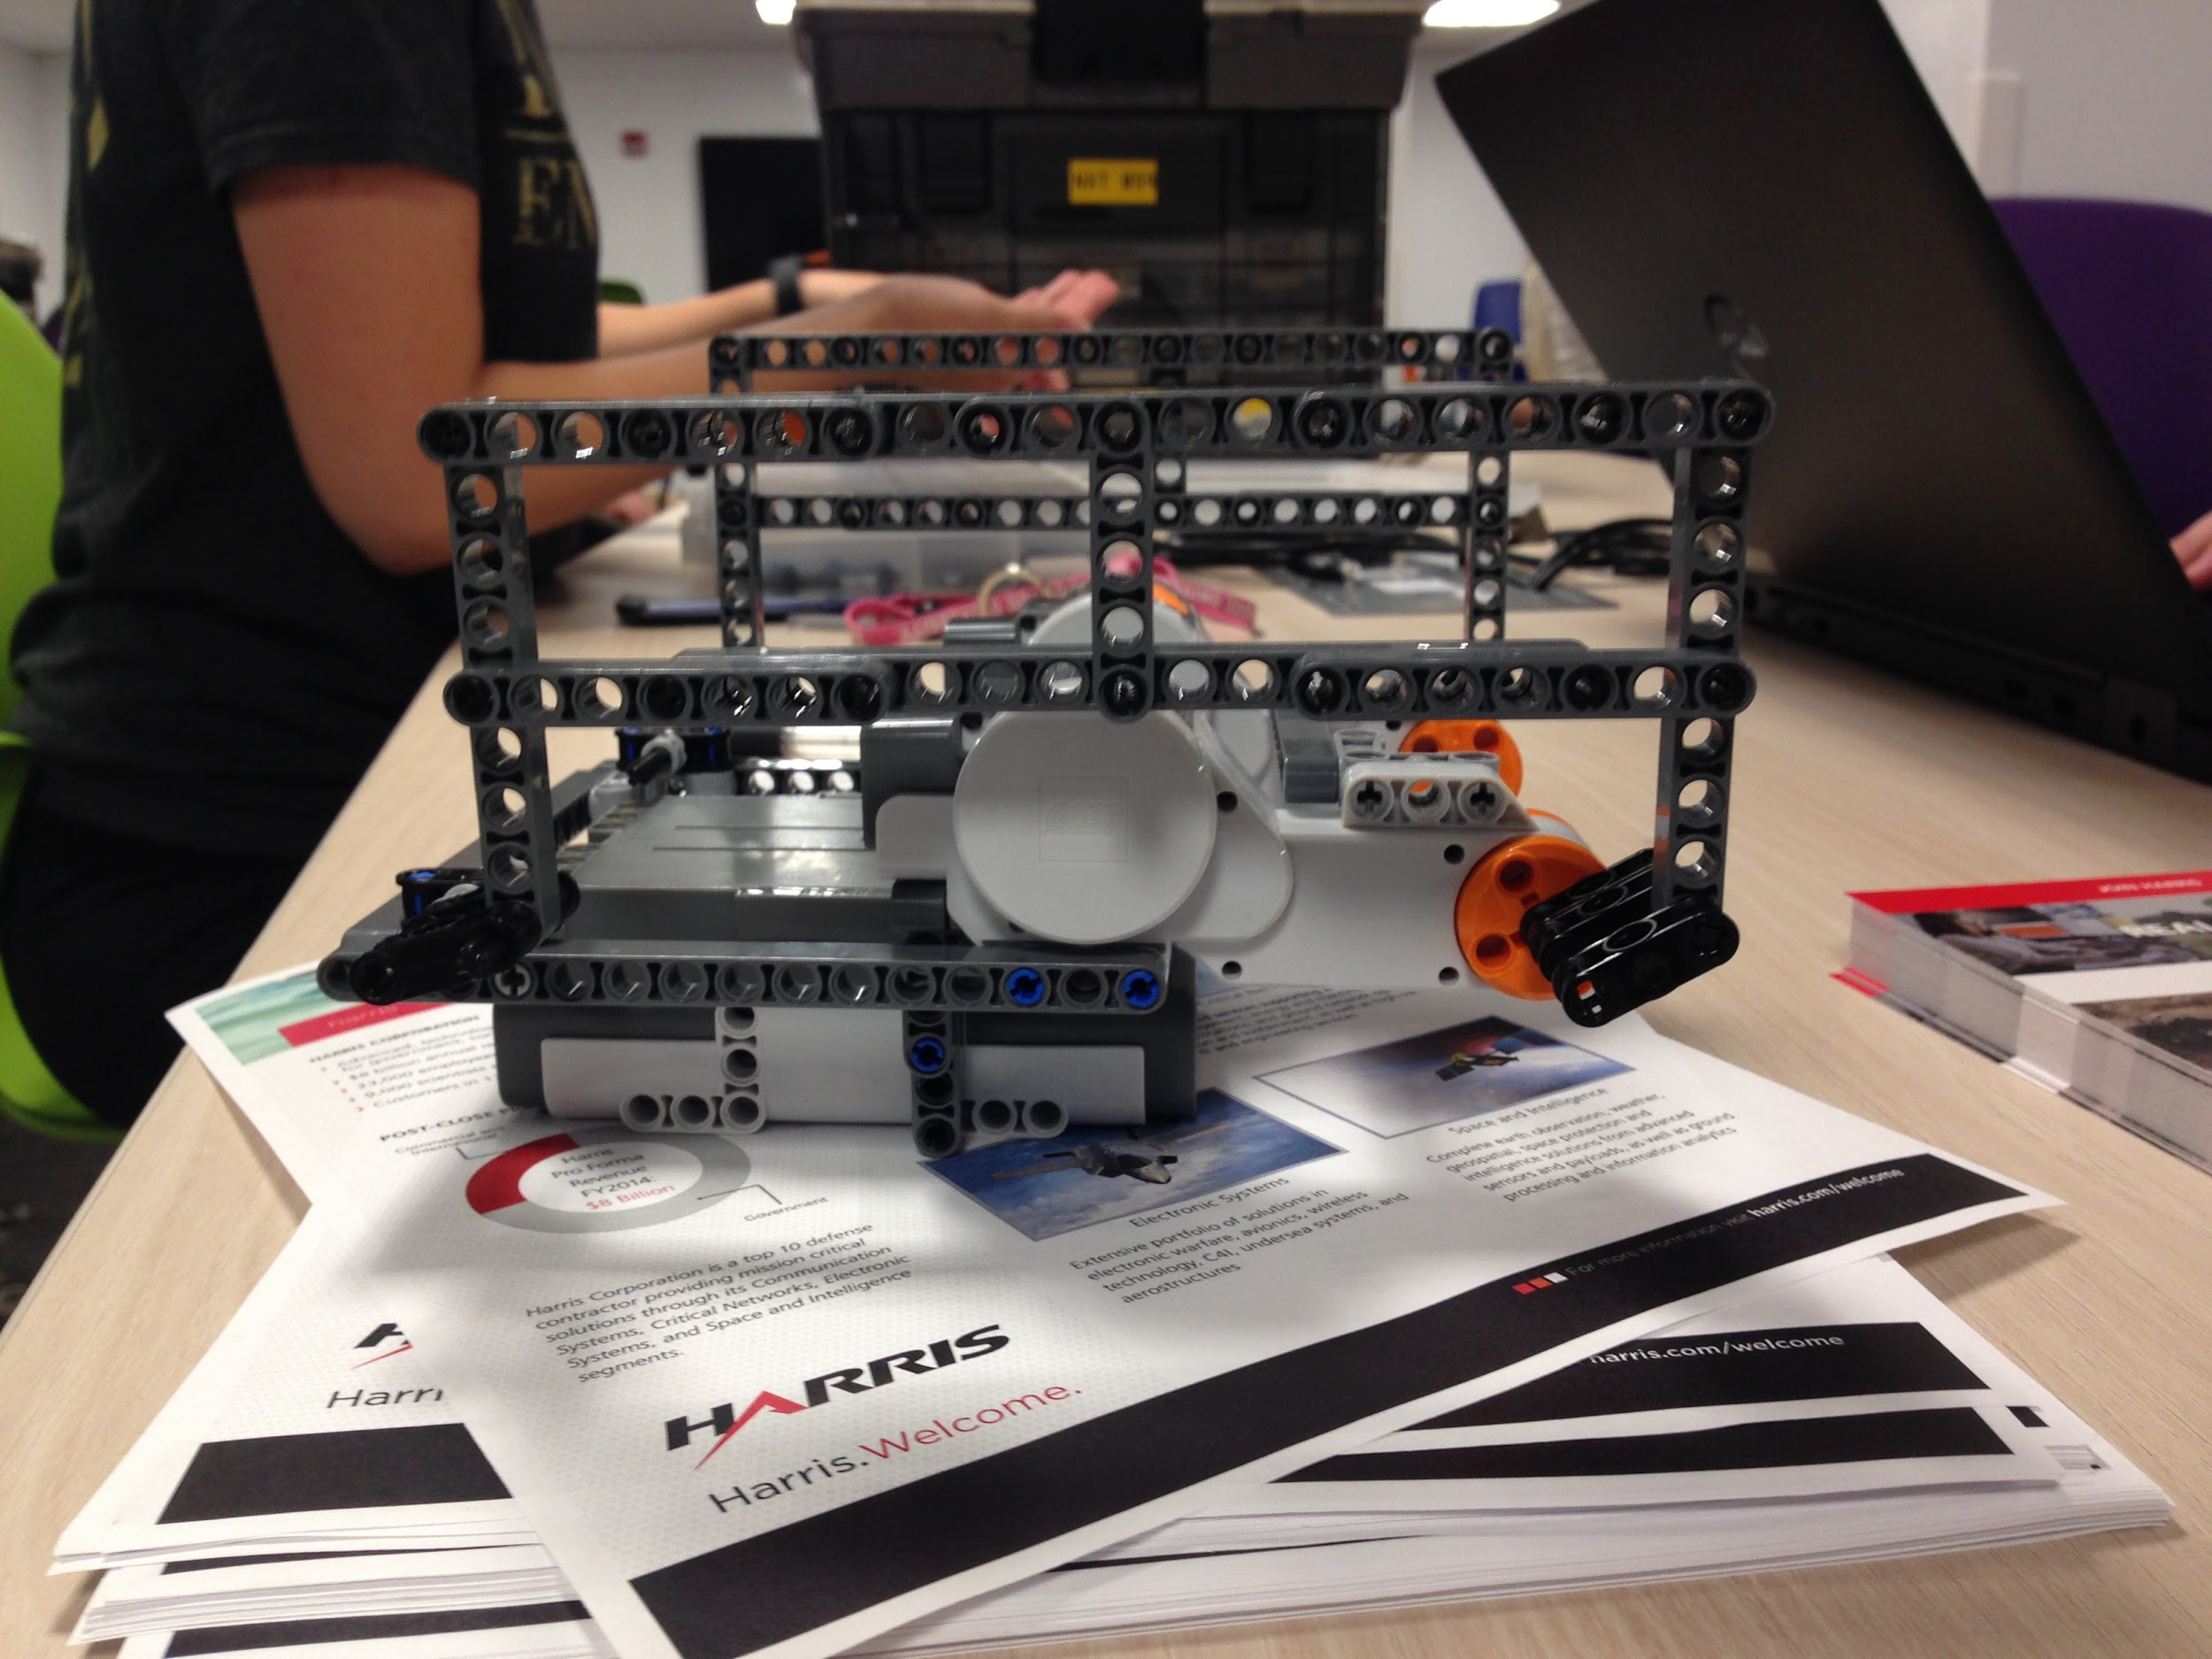
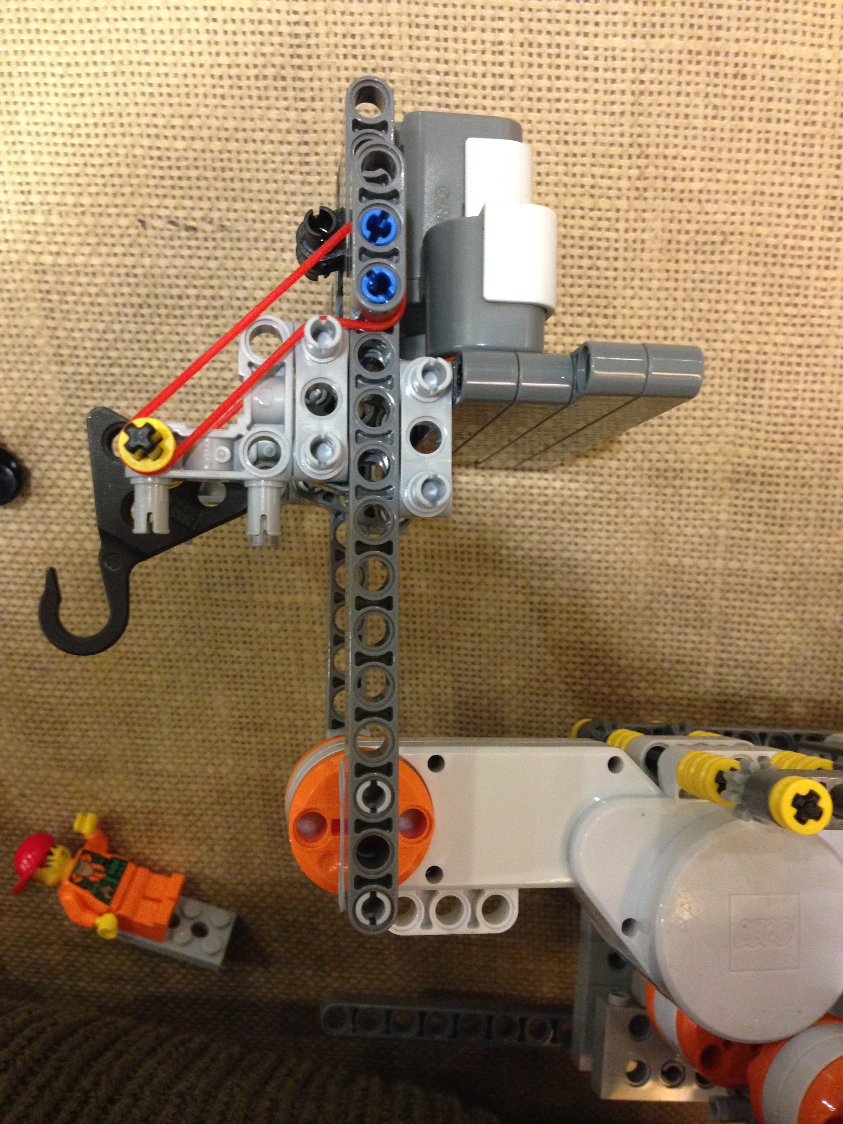
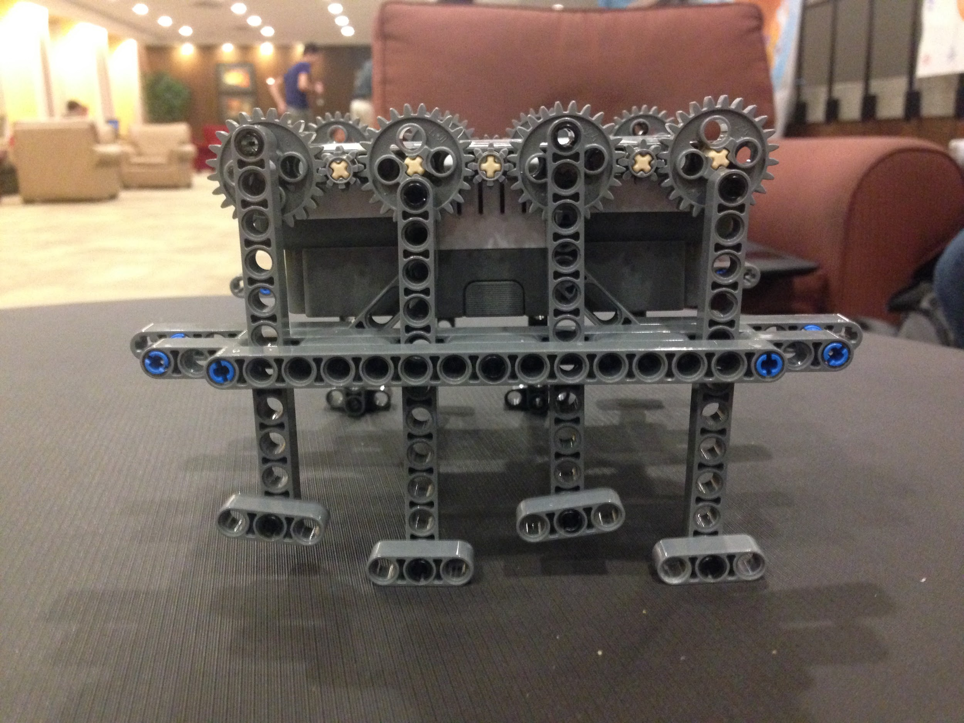
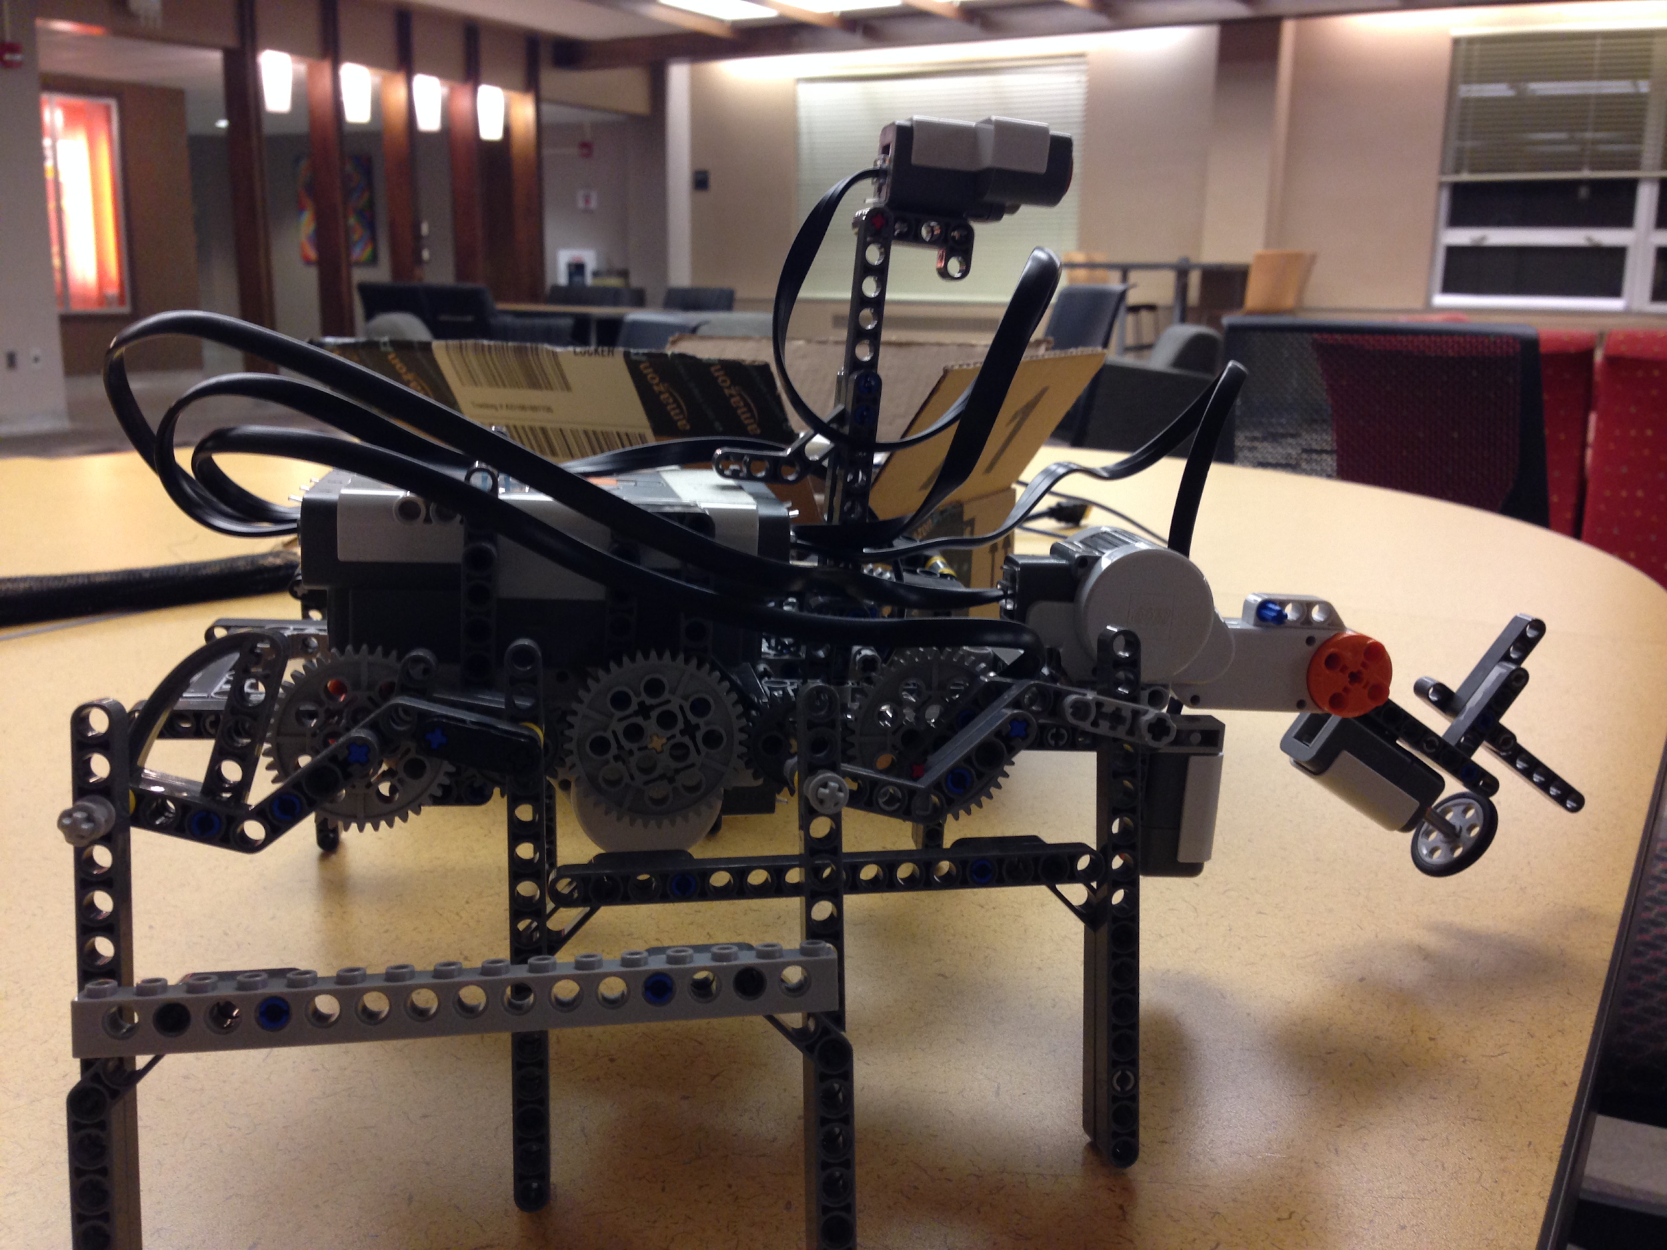
PROTOTYPE DESCRIPTIONS
Walker: 2 Bars as Feet
Walker: 3-4 Legs on Each Side, Pick-Up: Hook, Identification: Hook displacement
Walker: 3-4 Legs on Each Side, Pick-Up: Forklift, Identification: Power to lift the weight, Drop-Off Location: Touch Sensor, Bin Location: Touch Sensor
Walker: Combination, Pick up: Forklift, Identification: Power to lift the weight, Drop-Off Location: Ultrasonic Sensor, Bin Location: Touch Sensor
Notes:
We built prototypes using ideas from the morphological chart to test different designs and how components interacted.

Slide 9
DATA
Prototype | Performance
 | Walking Speed | Line Follow | Obstacle Height Traversal | Drop-Off Identification | Bin Pick Up % | Bin Identification%
1 | 0.23 ft/s | N/A | 0.75 inches | N/A | N/A | N/A
2 | 0.25 ft/s | N/A | 0.50 inches | N/A | 10% | 0%
3 | 0.25 ft/s | N/A | 0.50 inches | 50% | 100% | 87%
4 | 0.269 ft/s | 50% accurate | 2 inches | 100% | 100% | 87%
Notes:
Testing each prototype revealed their unique strengths and weaknesses

Slide 10
DESIGNS CHOSEN
Walking | 2 bars as feet “elephant” | 3 or 4 legs on each side “spider” |  |  |  |  | Combination 2 bars on each side with 4 legs
Pick - Up | Hook |  |  |  | Forklift
Bin Identification | Displacement of the hook |  |  |  | Power needed to lift the weight
Drop-Off Location | Touch Sensor - Walk into bin-drop off point identifier |  |  |  | Ultrasonic Sensor - Stop at a certain distance when object detected
Bin Location | Touch Sensor - Encounter bin
Notes:
As a result, we determined that <insert combo here> would be the most effective PMR design

Slide 11
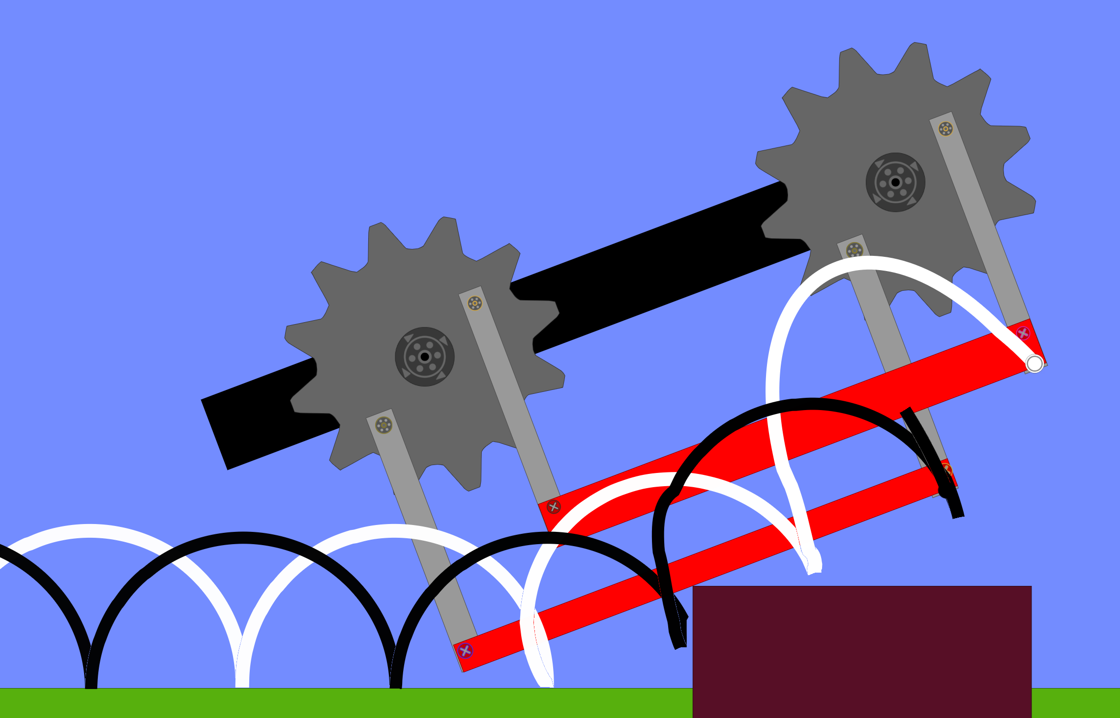
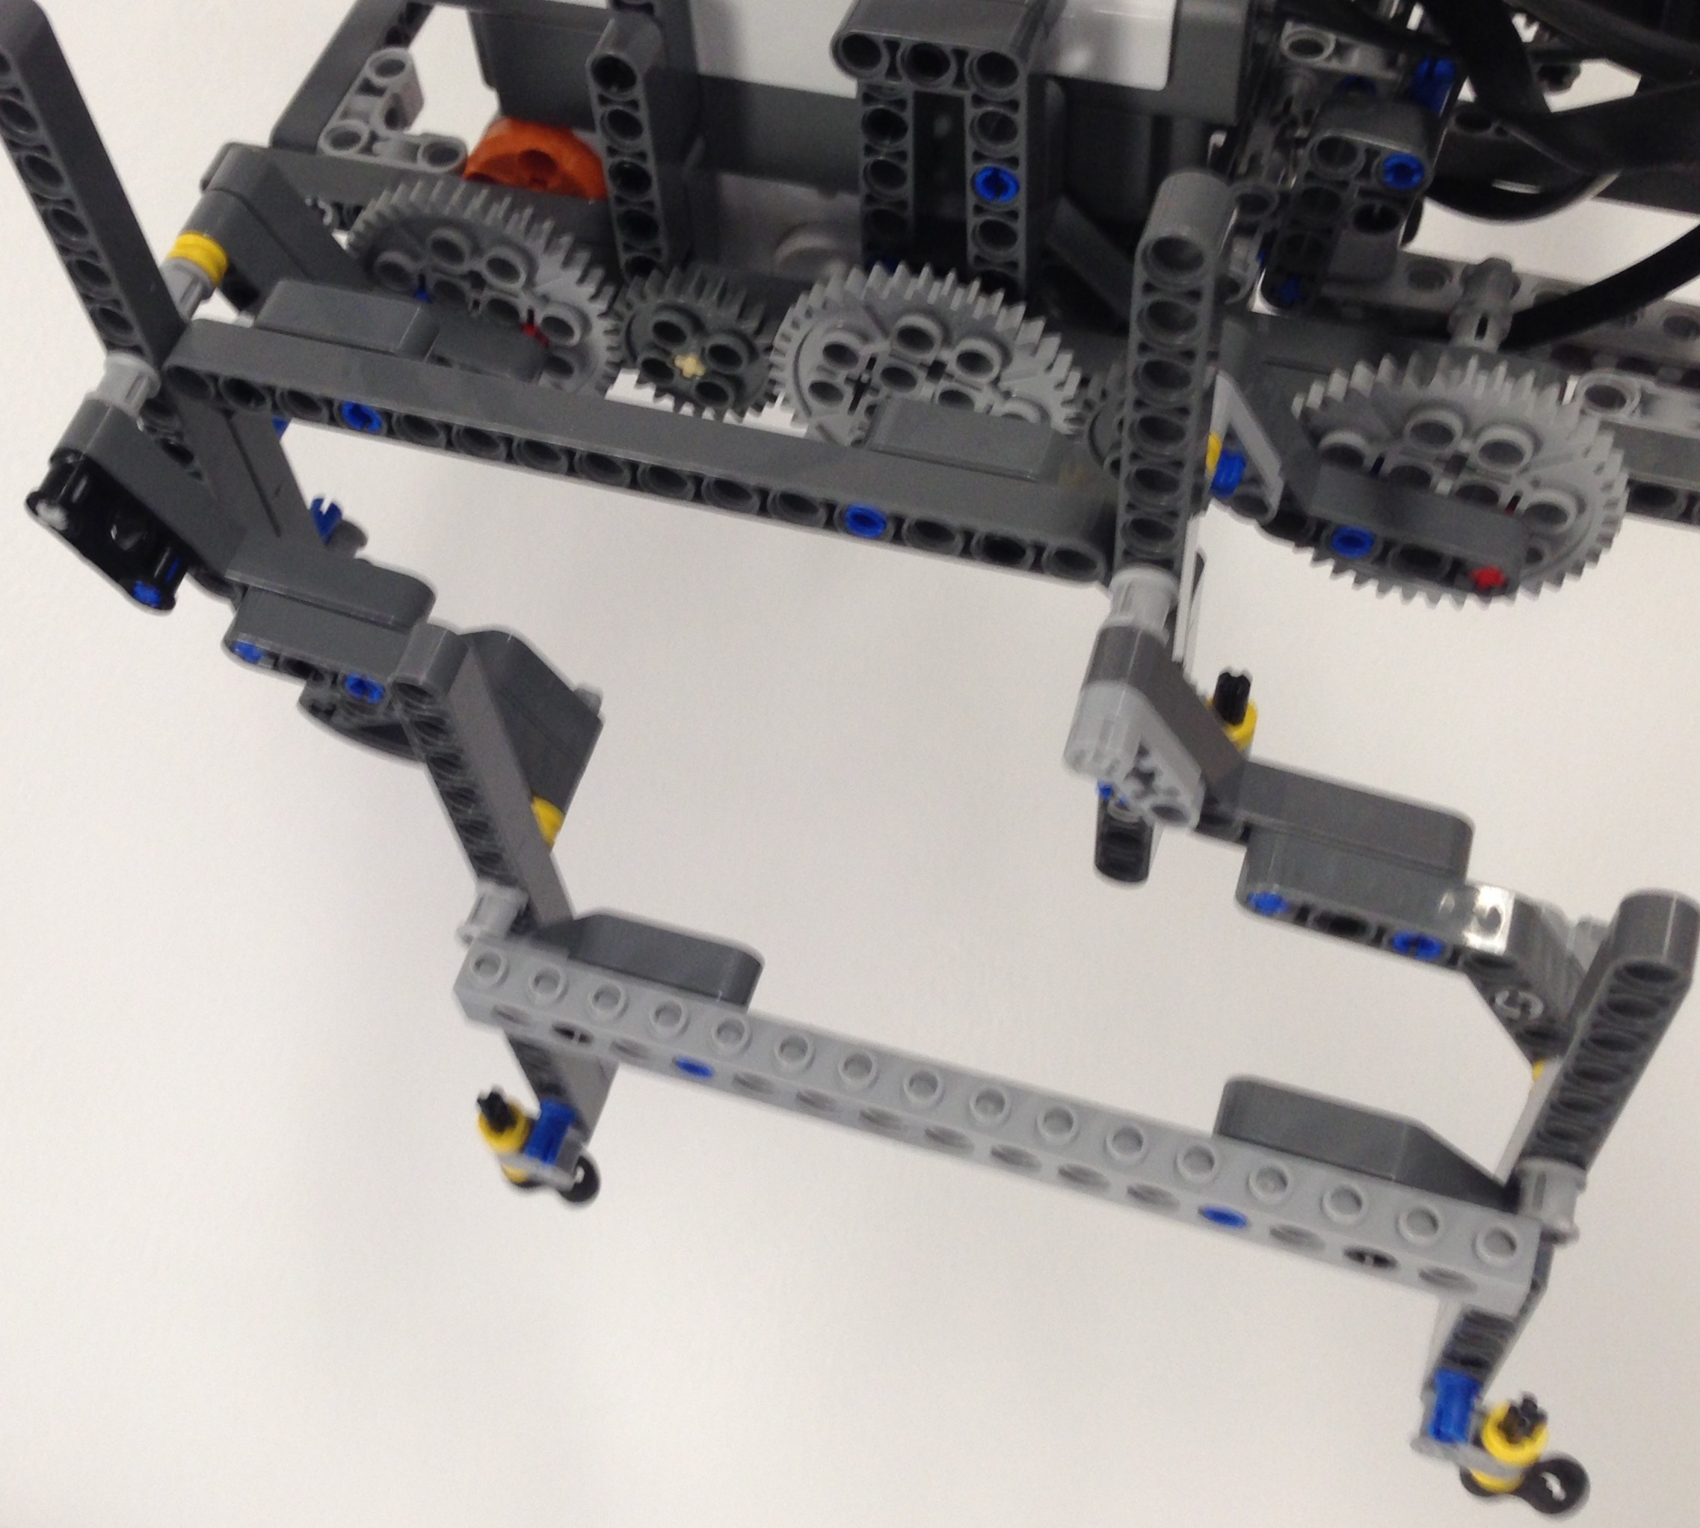
WALKING MECHANISM
Consists of two synchronized crankshafts both powered by one motor on each side
Crankshafts power 2 legs each, which are constrained to their equivalent on the other crankshaft.
Thus, the legs stay vertically oriented even though the center of mass of each leg travels in a circular motion.
This design allows the robot to easily clear large obstacles
Notes:
The final walking mechanism consisted of 2 alternating bars per side which would propel the PMR forward. We used simulations to confirm the efficacy of this design. <reference simulation picture and traces>. Thus, the PMR can overcome very tall obstacles.

Slide 12
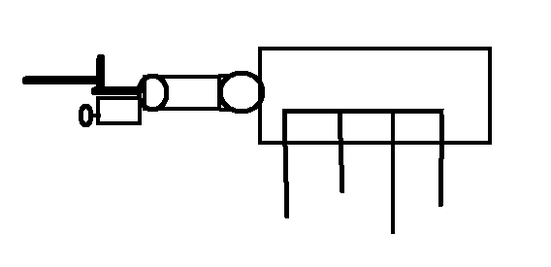
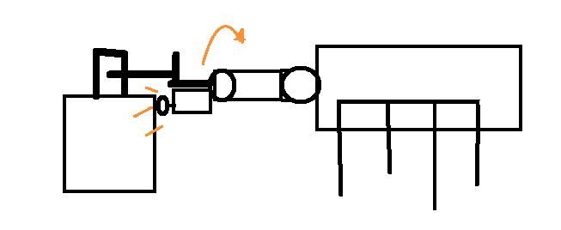
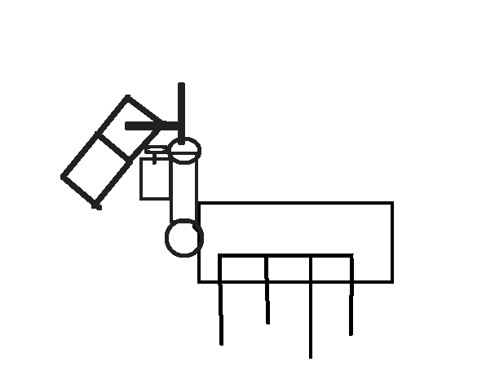
BIN PICK-UP
Follow line until touch sensor is depressed
Rotate the lift motor
Check with power 55
If bin lifted, contents are organic
Check with power 65
If bin lifted, contents are ceramic
Check with power 75
If bin lifted, contents are metallic
Output bin content
Continue following the line
Notes:
The PMR follows the line until the touch sensor is pushed, as we can see in the sketch. Once the touch was pressed the PMR stopped and moved the forklift back up with different powers to determine the bin content, and then outputted to the screen the content.

Slide 13
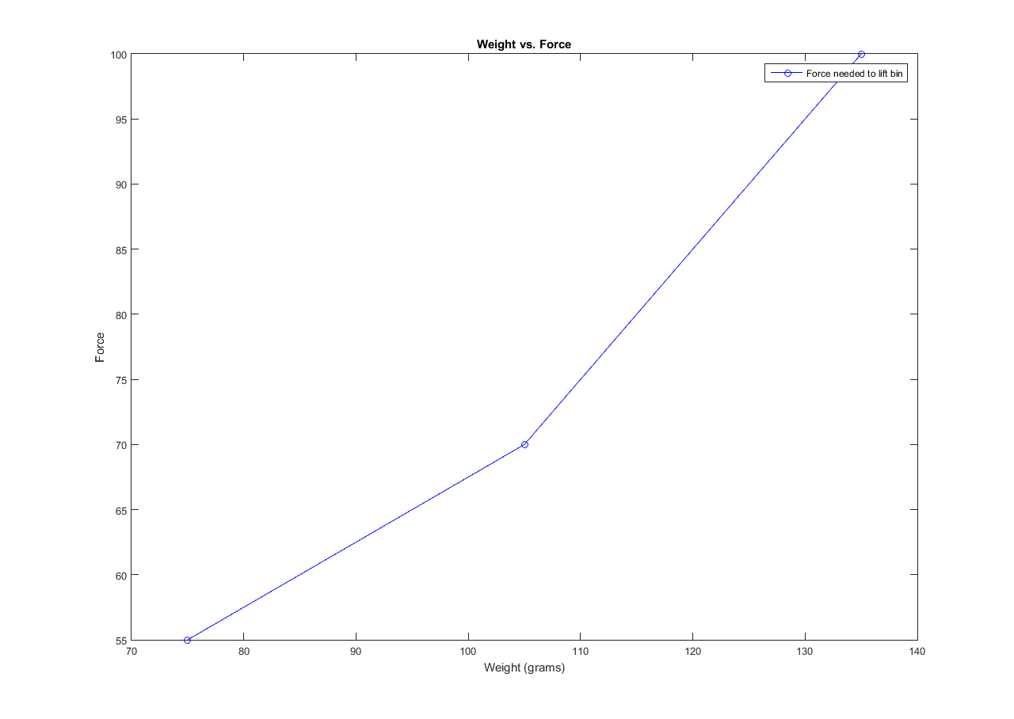
BIN IDENTIFICATION
Bin Type | Max Weight | Power Level Requirement to Lift
Organic | 75 grams | 55
Ceramic | 105 grams | 65
Metallic | 135 grams | 75
Notes:
As we can see in this graph presented, different power levels are needed to lift different weights. We determined the power needed for the maximum weight of each bin. And if the bin was successfully lifted, the touch sensor was pushed in, to confirm the content of the material.

Slide 14
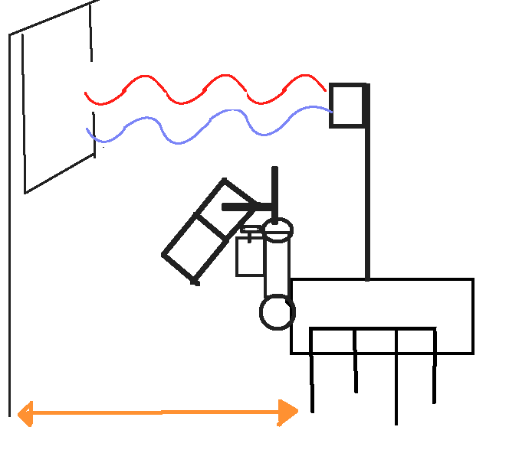
DROP-OFF LOCATION
Flag is placed at drop off location as identifier
Ultrasonic sensor checks for presence of flag
Robot stops when the flag is detected 12 in. away
Now, the robot is positioned to drop the bin in the center of the drop off location
Depending on bin contents and the number of drop off locations the robot has already encountered, it either drops the bin or continues to the next drop off location.
Notes:
In order to identify the bin drop-off locations, flags were created and placed at the drop-off locations as identifiers. As the PMR travels around the track, the ultrasonic sensor checks for the presence of the flag. The robot stops when the flag is detected at less than 1 foot away and beeps 3 times, as this allows for the robot to drop the bin at the center of the drop-off location. Depending on the bin contents, and the number of drop-off locations that the robot has already encountered, it either drops the bin or continues to the next drop-off location.

Slide 15
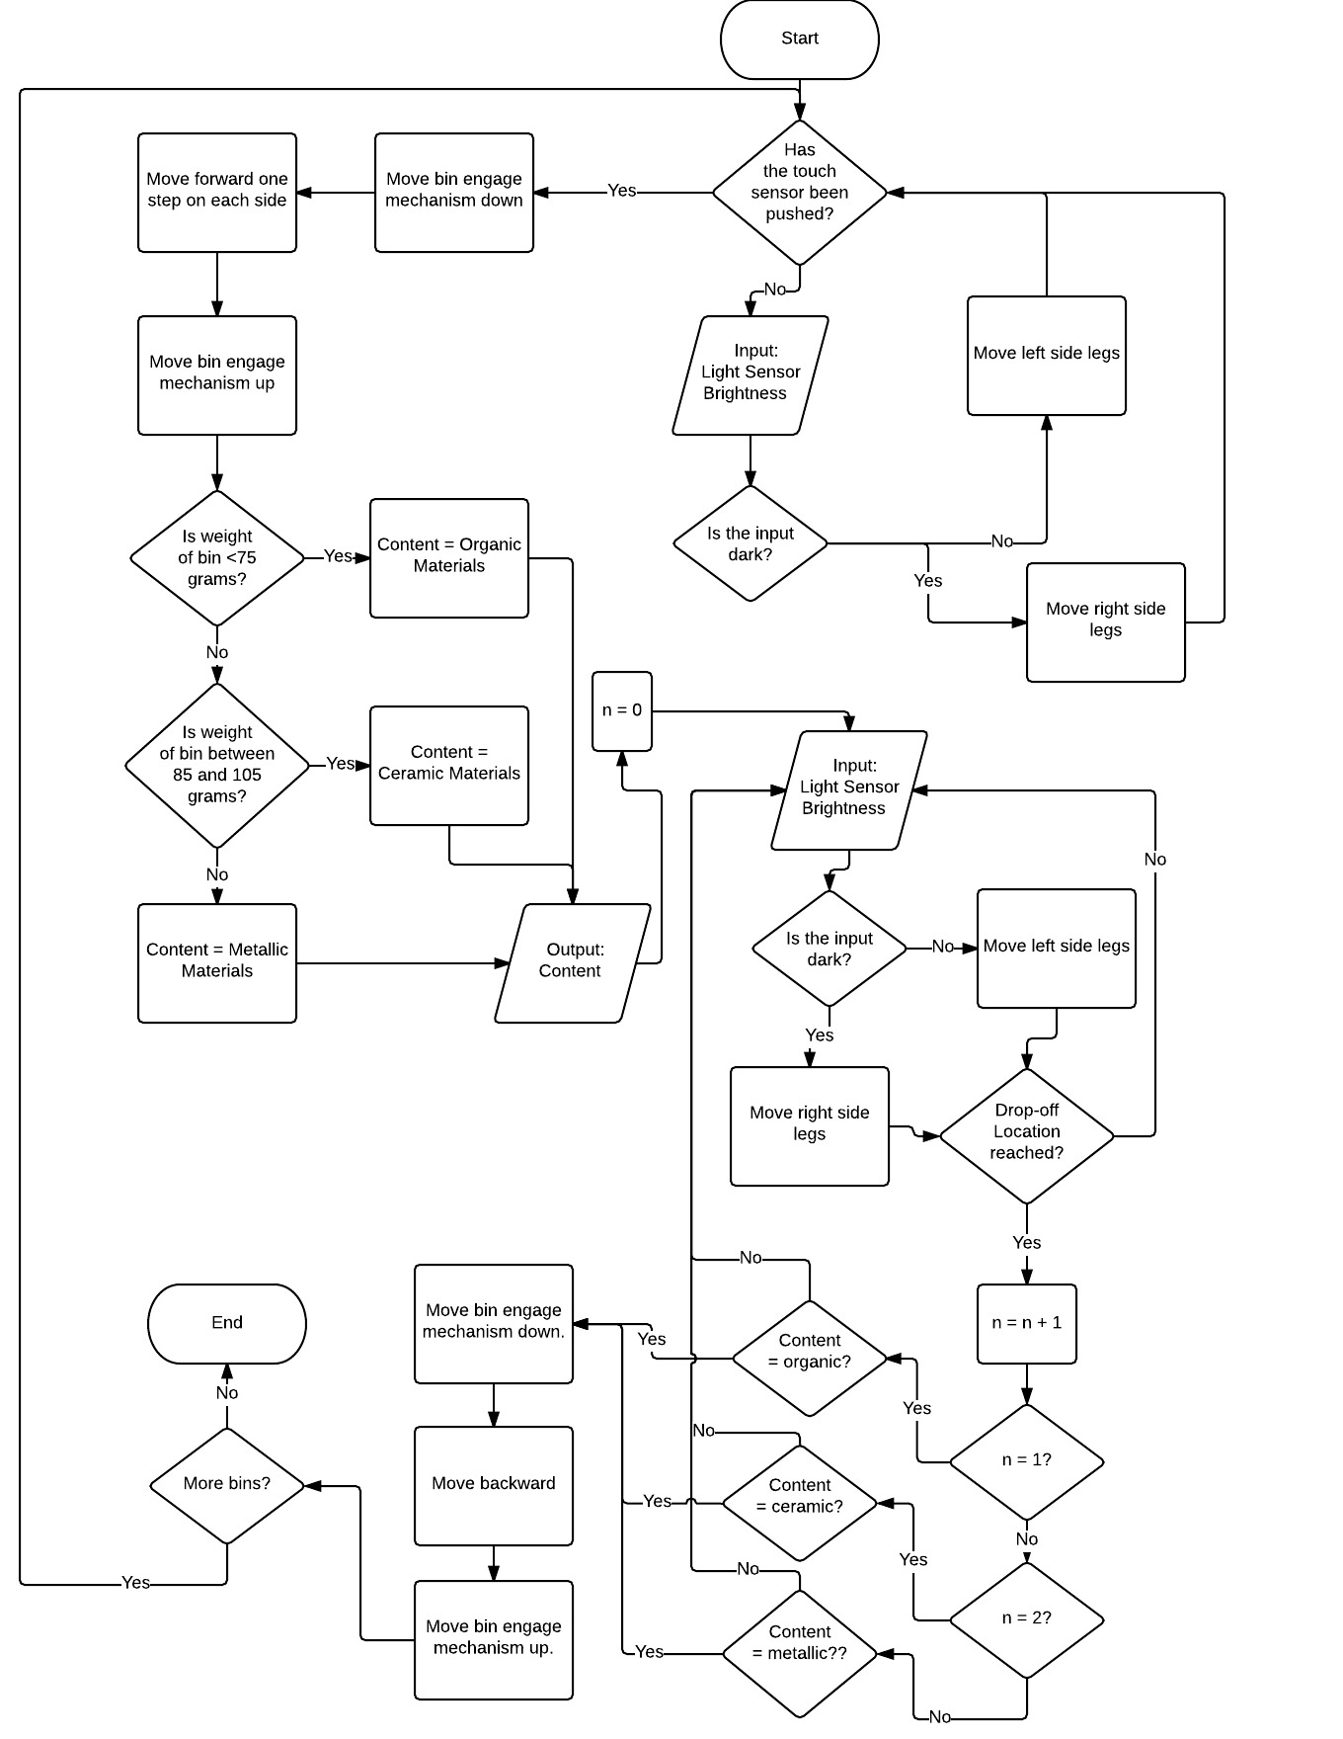
Code
Use light sensor input to follow line until touch sensor is depressed
Check bin weight by rotating bin motor at varying powers
Determine and output bin contents
Use light sensor input to follow line until next drop off location has been reached
If the drop off location is correct for the bin, drop the bin and continue. Else, return to step 4
Return to step 1
Notes:
The flowchart on the left shows the logic for our code. Here is a quick breakdown. The robot begins by using the light sensor input to follow the line until the touch sensor is depressed by a bin. The PMR then attempts to lift the bin at varying powers to determine the identity of the bin, as Natalie described earlier. The light sensor then guides the robot around the path until a drop-off location is identified, as was explained in the previous slide. If the drop-off location is the correct number for the contents of the bin, the robot will turn to the side slightly, drop the bin, back up turn back, and continue along the path. Otherwise, it continues to walk until the next drop-off location has been reached and repeats the process. Once a bin has been placed, the robot continues to follow the closed-loop path until the touch sensor is depressed again.

Slide 16
PERFORMANCE
DESIGN ADVANTAGES
Able to clear tall obstacles
Fast
Simply and effectively identifies bins
Ultrasonic sensor allows reliable identification of drop-off locations
Drop off location markers are simple and easy to construct.
DESIGN DISADVANTAGES
Line following program is unreliable
Grasping mechanism prone to being knocked out of position during locomotion
Design requires stronger motors
Fails to work if batteries are even partially drained
Touch sensor requires too much force to identify the presence of a bin

Slide 17
CONCLUSION
Did not perform as desired at the demonstration
Line following program did not work effectively
In prior testing only able to follow solid black lines
In demonstration started with curved black line and straight dotted
Unable to display abilities in other tasks
Recommended Improvements:
Line following → Develop a more effective program
Walking mechanism → Reduce step size to ease line following
Bin pick-up mechanism → Make more stable
Bin recognition → Make touch sensor more sensitive
Lighter robot → Ensure motors are strong enough to move the robot
Notes:
In conclusion, we believed that our PMR would work effectively throughout the demonstration due to the reasoning behind our designs, as well as the data we collected about our robot’s performance before attending the demo. However, in practice, the PMR did not perform as desired, as the line follow program did not work as effectively as it did in our testing, and thus the PMR was unable to reach the parts of the path where it could demonstrate its abilities in other tasks. In order to improve our PMR design, we recommend that a new, more effective line following program is developed, and the step size of the walking mechanism is reduced in order to ease the line following process and ensure that the PMR gets the chance to display all abilities. We also recommend that the forklift of the bin pick-up mechanism is made more stable so as to prevent the touch sensor from being depressed from it being hit into the ground as the robot bounces from walking. We also recommend that the touch sensor on the bin recognition mechanism is made more sensitive in order to increase the accuracy of the mechanism. Finally, we recommend that the robot is made with lighter materials in its chassis in order to ensure that the motors are strong enough to move the robot forward, while still being stable enough to support the weight of the robot and the bins.

Slide 18
Questions?
Notes:
Thank you for your time. We would now like to open the floor up for questions.

